Slide 1
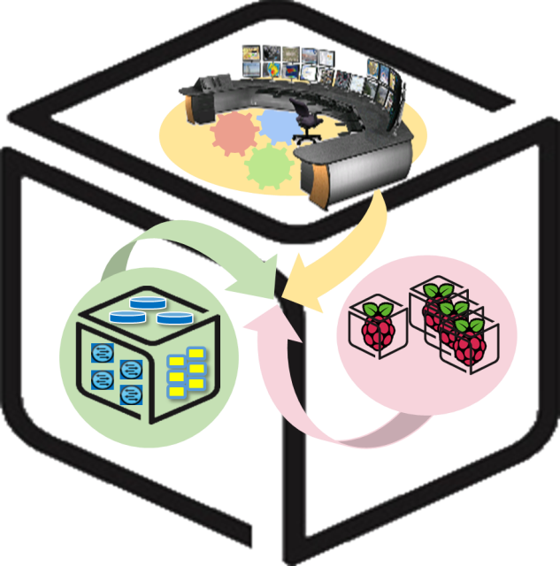
SmartX Labs for Computer Systems
Cluster Lab
(2016, Spring)
NetCS Lab

Slide 2
History and Contributor of Cluster Lab
(2016. 06. 30.)
Version | Updated Date | Updated Contents | Contributor
- | 2015/10 | (구) Analytics Lab 작성 | 송지원
v1 | 2016/04 | Cluster Lab 초안 작성 | 김승룡
v2 | 2016/05 | Cluster Lab 수정 | 송지원
v3r3 | 2016/05/28 | Cluster Lab 2차 수정 (내용 수정 및 추가) | 송지원
v4r1 | 2016/05/30 | Cluster Lab 3차 수정 (피드백 반영) | 송지원
v5 | 2016/06/01 | HDFS를 옵션으로 변경, 기타 문제 수정 | 송지원
v6r1 | 2016/06/03 | 실습자 검수 후 수정 | 송지원, 윤희범, 남택호
v6r2 | 2016/06/29 | HDFS 설치 과정 등 수정 | 송지원
v6r3 | 2016/06/30 | Zeppelin 독립 실행 모드 설명 추가 | 송지원
0.6.4 | 2016/07/04 | Zeppelin 설치 방법 누락된 부분 추가 | 송지원

Slide 3






CSLab: Cluster LAB
- Goal
SETUP to run data processing and visualization
Install Mesos, HDFS, Spark, Zeppelin on NUC

Slide 4

Apache Mesos - Concept
What is Mesos?
A distributed systems kernel
Mesos is built using the same principles as the Linux kernel, only at a different level of abstraction. The Mesos kernel runs on every machine and provides applications (e.g., Hadoop, Spark, Kafka, Elastic Search) with API’s for resource management and scheduling across entire datacenter and cloud environments.
Cloud as a single computer
Share resources across the machines
…

Slide 5
Apache Mesos - Architecture
1
I need 2 CPUs!
Framework
3
Framework, use 2 CPUs in Slave 1
Mesos Master
2
I have 2 CPUs
Mesos Slave 1
Mesos Slave 2
Mesos Slave 3

Slide 6
HDFS - Concept
Hadoop Distributed FileSystem
A distributed file system that provides high-throughput access to application data.
Features
Fault tolerance by detecting faults and applying quick, automatic recovery
Portability across heterogeneous commodity hardware and operating systems
Scalability to reliably store and process large amounts of data
Economy by distributing data and processing across clusters of commodity personal computers
Efficiency by distributing data and logic to process it in parallel on nodes where data is located
Reliability by automatically maintaining multiple copies of data and automatically redeploying processing logic in the event of failures

Slide 7
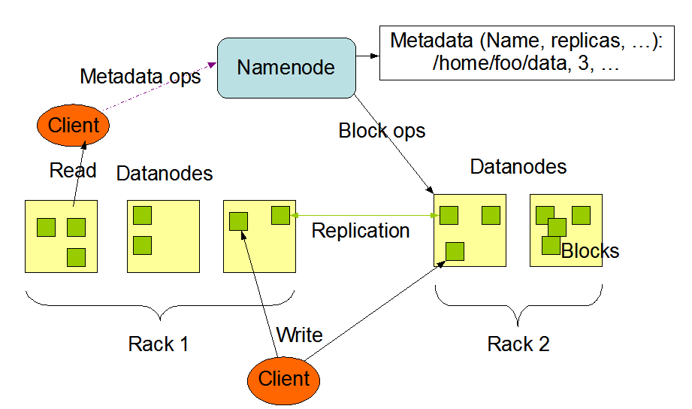
HDFS - Architecture
<Master/Slave architecture>
NameNode: A single node which manages the file system namespace and regulates access to files by clients.
DataNode: DataNodes manage storage attached to the nodes that they run on.

Slide 8

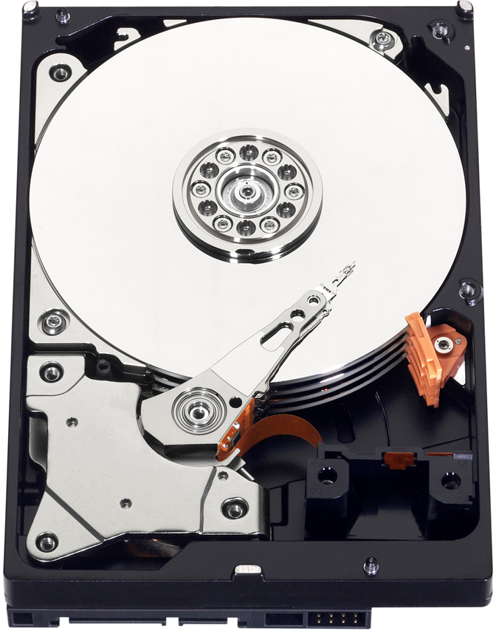
HDFS - Architecture
HDFS makes storages of separate machines in cluster into a single storage.
DataNode
DataNode

Slide 9
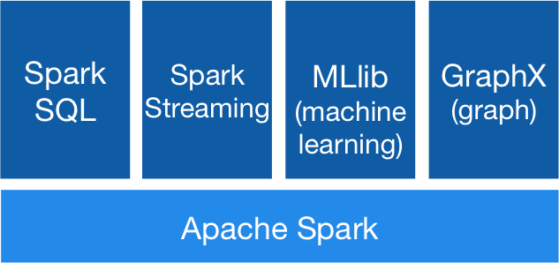
Apache Spark - Concept
Apache Spark™ is a fast and general engine for large-scale data processing.
In-memory data processing framework: Fast!
Easy to use, community fastly growing
Libraries: SQL and DataFrame, Streaming, MLlib, GraphX
Run on standalone or Mesos, Yarn, etc
Scala, Java, Python

Slide 10
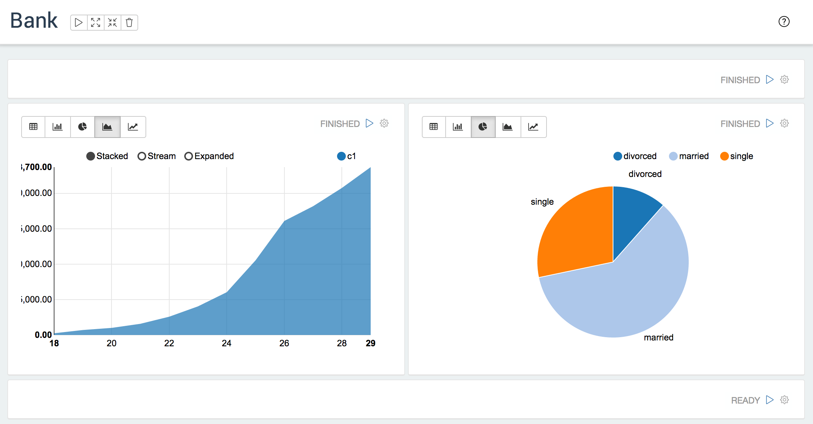
Apache Zeppelin
-Concept
A web-based notebook that enables interactive data analytics.
Support Spark

Slide 11

0. Cluster Overview
Prerequisite: Ubuntu 14.04 - 64bit.
(To install Java, see AppServer Lab.)
RAM of Tower VM should >= 2GB.
MM
HN
Z
MM
Mesos Master
Mesos Slave
HDFS NameNode
HDFS DataNode
Zookeeper
Spark
Zeppelin
MS
SP
ZP
HN
HD
Z
SP
ZP
MS
HD
MS
HD

Slide 12


0. Preparation - Install Java
Install JAVA JDK 8
$ sudo add-apt-repository ppa:webupd8team/java
$ sudo apt-get update
$ sudo apt-get install oracle-java8-installer
If fail to install JAVA like
error: sudo add-apt-repository: command not found
Follow command
$ sudo apt-get install software-properties-common python-software-properties
$ sudo apt-get update
Do this for all tower and NUCs.
If you already installed Java 8 in previous labs, you can skip it.

Slide 13
0. Preparation - Configure accounts
Do this for all tower and NUCs.
Set root password
sudo passwd
Create Hadoop account and login
sudo -s
adduser hadoop
adduser hadoop sudo
su hadoop #login as ‘hadoop’
This procedure is required when you install HDFS.

Slide 14
0. Preparation - Configure hostnames
Do this for all tower and NUCs.
Edit /etc/hosts
sudo vi /etc/hosts
127.0.0.1 localhost
192.168.0.1 tower
192.168.0.2 nuc01
192.168.0.3 nuc02
Edit:
EX)

Slide 15
1. Apache Mesos - Install
Mesos Master
Zookeeper
Mesos Slave
Mesos Slave

Slide 16
1. Apache Mesos - Installation Procedure
Add Mesosphere repository
Install Mesos Master
Install Mesos Slave
Check on the Web UI

Slide 17
1. Apache Mesos - Install: Add Mesosphere repository
Add the repository to Tower and NUCs.
sudo apt-key adv --keyserver keyserver.ubuntu.com --recv E56151BF
DISTRO=$(lsb_release -is | tr '[:upper:]' '[:lower:]')
CODENAME=$(lsb_release -cs)
To check you correctly input, use echo command.
echo $DISTRO $CODENAME
ubuntu trusty
echo "deb http://repos.mesosphere.io/${DISTRO} ${CODENAME} main" | sudo tee /etc/apt/sources.list.d/mesosphere.list
sudo apt-get -y update

Slide 18
1. Apache Mesos - Install: Mesos Master
sudo apt-get -y install mesos
sudo reboot
sudo service mesos-slave stop
echo manual | sudo tee /etc/init/mesos-slave.override
echo <TOWER_IP_ADDR> | sudo tee /etc/mesos-master/ip
echo <TOWER_HOSTNAME> | sudo tee /etc/mesos-master/hostname
echo zk://<TOWER_IP_ADDR>:2181/mesos | sudo tee /etc/mesos/zk
echo <NAME> | sudo tee /etc/mesos-master/cluster
sudo service zookeeper restart
sudo service mesos-master restart
echo 1 | sudo tee /etc/zookeeper/conf/myid
NAME: anything you want

Slide 19
1. Apache Mesos - Install: Mesos Slave
sudo apt-get -y install mesos
sudo reboot
sudo service mesos-master stop
echo manual | sudo tee /etc/init/mesos-master.override
sudo service zookeeper stop
echo manual | sudo tee /etc/init/zookeeper.override
sudo apt-get -y remove --purge zookeeper
echo <NUC_IP_ADDR> | sudo tee /etc/mesos-slave/ip
echo <NUC_HOSTNAME> | sudo tee /etc/mesos-slave/hostname
echo zk://<TOWER_IP_ADDR>:2181/mesos | sudo tee /etc/mesos/zk
echo HADOOP_HOME=/usr/local/hadoop | sudo tee –a /etc/default/mesos-slave
sudo reboot
HADOOP_HOME will be needed later if you want to use Spark with HDFS.

Slide 20

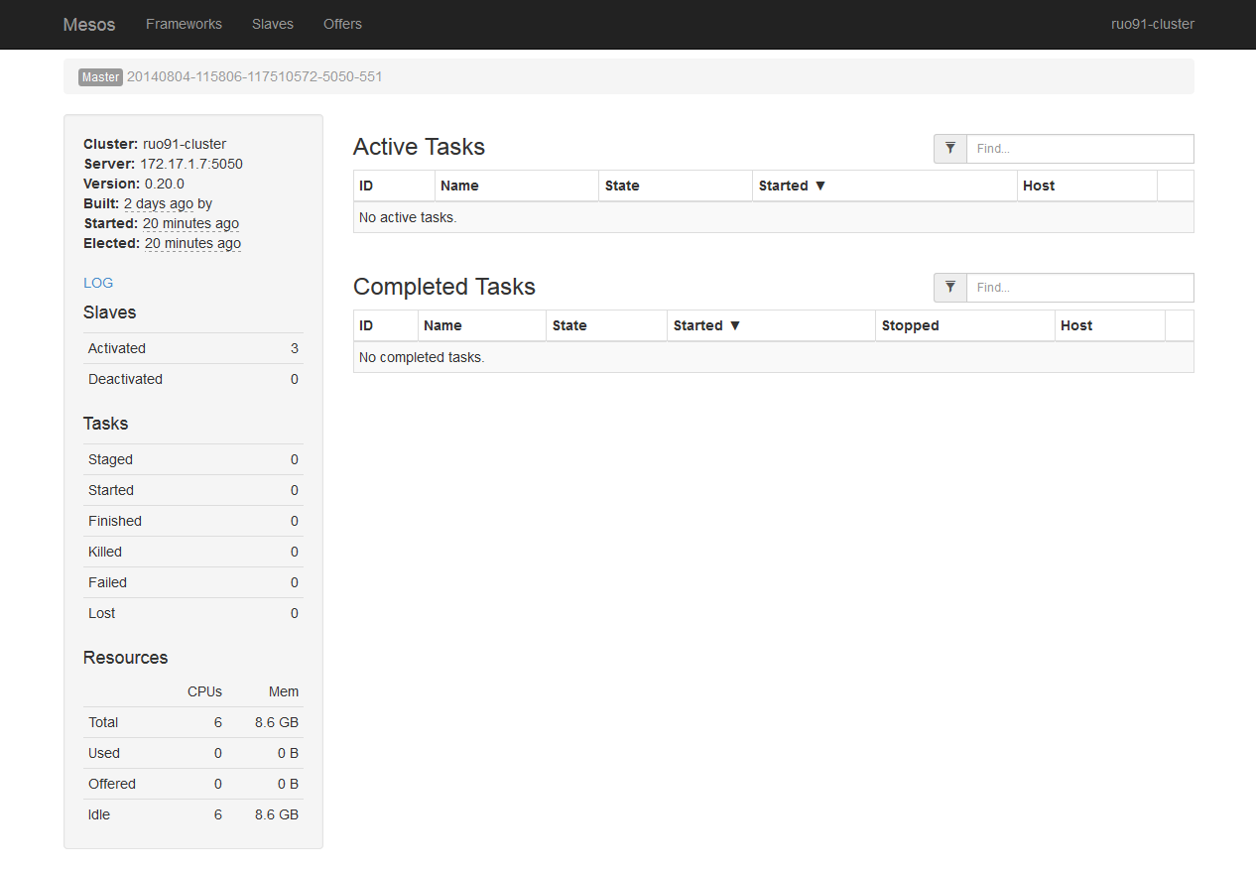
1. Apache Mesos - Check on the Web UI
In your web browser, go to
http://<MASTER-IP-ADDR>:5050
Check the activated slaves and resources.

Slide 21
2. Apache Spark - Install
1. Download and unarchive Spark binary for all Tower and NUCs.
cd ~
wget http://mirror.apache-kr.org/spark/spark-1.6.2/spark-1.6.2-bin-hadoop2.6.tgz
tar xzf spark-1.6.2-bin-hadoop2.6.tgz
2. On Tower, configure spark-env.sh file.
cd spark-1.6.2-bin-hadoop2.6/conf
cp spark-env.sh.template spark-env.sh
vi spark-env.sh
Edit:
export MESOS_NATIVE_JAVA_LIBRARY=/usr/local/lib/libmesos.so
export MASTER=mesos://<TOWER_IP>:5050

Slide 22
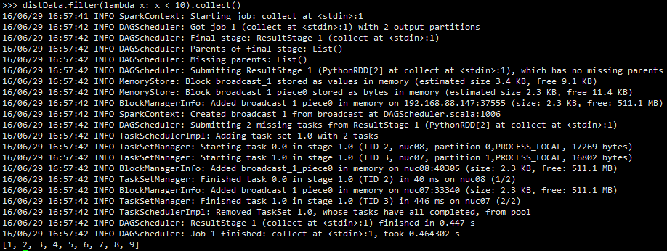
2. Apache Spark - Test
Go to Mesos web UI and see Spark framework running.
# Test Spark: In Tower
cd ..
bin/pyspark
>>> data = range(1, 10001)
>>> distData = sc.parallelize(data)
>>> distData.filter(lambda x: x < 10).collect()

Slide 23
3. Apache Zeppelin - Install (on Mesos)
# Work in home directory.
wget http://mirror.apache-kr.org/incubator/zeppelin/0.5.6-incubating/zeppelin-0.5.6-incubating-bin-all.tgz
tar xzf zeppelin-0.5.6-incubating-bin-all.tgz
cd zeppelin-0.5.6-incubating-bin-all/conf
cp zeppelin-env.sh.template zeppelin-env.sh
vi zeppelin-env.sh
Start Zeppelin daemon.
cd ..
bin/zeppelin-daemon.sh start
Edit:
export MESOS_NATIVE_JAVA_LIBRARY=/usr/local/lib/libmesos.so
export MASTER=mesos://<MASTER_IP_ADDR>:5050
export SPARK_HOME=/home/<user>/spark-1.6.1-bin-hadoop2.6
http://<Tower IP-ADDR>:8080
Notes:
cluster

Slide 24
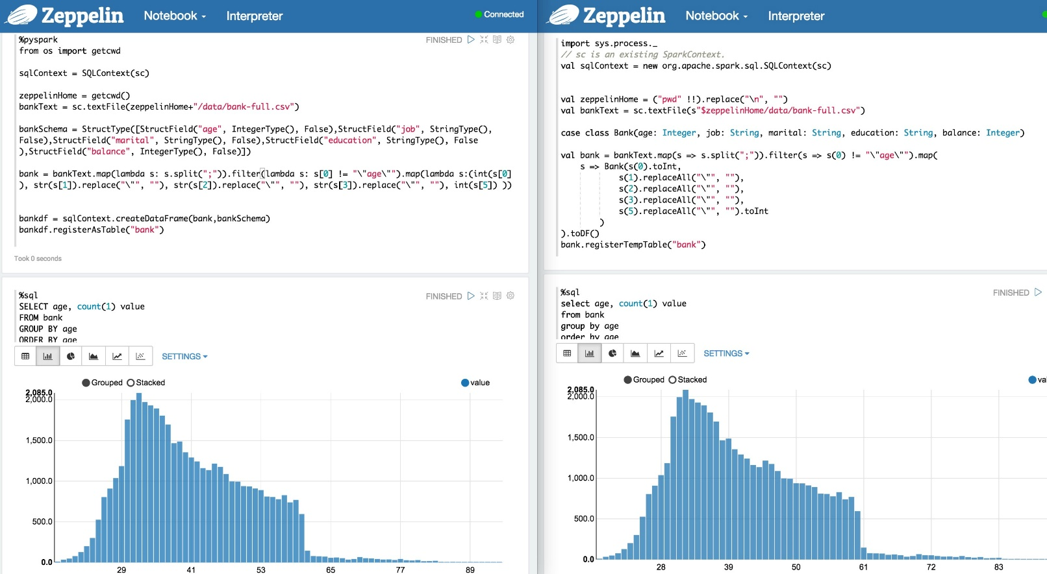
3. Apache Zeppelin - Run Example
In Zeppelin tutorial, Press ‘Run’ button to test.

Slide 25
3. Apache Zeppelin - Tip: Zeppelin Standalone mode
If you have trouble running Zeppelin on Mesos, or have only one machine, then you can run Zeppelin in standalone mode.
If you already made configuration file, remove it first.
rm conf/zeppelin-env.sh
Without any configuration, just start Zeppelin daemon.
bin/zeppelin-daemon.sh start
#(or if daemon is already running, use ‘restart’ instead of ‘start.’)

Slide 26
4. HDFS (Optional) - Install
HDFS NameNode
HDFS DataNode
HDFS DataNode

Slide 27
4. HDFS (Optional) - Installation Procedure
Set hostnames
Configure accounts and SSH settings
Download and Unzip Hadoop
Configure HDFS
Start and test

Slide 28
4-1. HDFS - Configure accounts and SSH settings
Log in to user ‘hadoop’.
su hadoop
Generate key (just press enter x 3) in tower and NUCs
ssh-keygen -t rsa
cp /home/hadoop/.ssh/id_rsa.pub /home/hadoop/.ssh/authorized_keys
Modify key permission
cd .ssh
chmod 644 authorized_keys
Copy key from Tower to all NUCs
scp authorized_keys hadoop@<NUC_IP>:~/.ssh/
Try to login via SSH to check if you can login to NUC without password.

Slide 29
4-1. HDFS - Download and Unzip Hadoop
Download and Unzip in all Tower and NUCs.
cd
wget http://mirror.apache-kr.org/hadoop/common/hadoop-2.7.2/hadoop-2.7.2.tar.gz
tar -xvzf hadoop-2.7.2.tar.gz
sudo mv hadoop-2.7.2 /usr/local/hadoop
Go to the directory which contains configuration files.
cd /usr/local/hadoop/etc/hadoop
We will edit these files:
hadoop-env.sh, core-site.xml, hdfs-site.xml, slaves

Slide 30
4-1. HDFS - Configuration
Edit these files.
<hadoop-env.sh> file
export JAVA_HOME=/usr/lib/jvm/java-8-oracle
<core-site.xml> file
<configuration> <property> <name>fs.defaultFS</name> <value>hdfs://tower_hostname:9000/</value> </property> </configuration>
Edit:
Edit:
This option must be a hostname, not IP address.

Slide 31
4-1. HDFS - Configuration
<hdfs-site.xml> file
<configuration>
<property>
<name>dfs.replication</name>
<value>2</value>
</property>
<property>
<name>dfs.namenode.name.dir</name>
<value>file:///usr/local/hadoop/namenode</value>
</property>
<property>
<name>dfs.datanode.data.dir</name>
<value>file:///usr/local/hadoop/datanode</value>
</property>
</configuration>
<slaves> file: Add hostname or IP address of all NUCs, one per line.
Ex)
nuc1
nuc2
Edit:

Slide 32
4-1. HDFS - Configuration
Deploy configuration files from Tower to all slaves.
cd ..
scp –r hadoop hadoop@<NUC_IP>:/usr/local/hadoop/etc/
In NUCs, make DataNode directory.
mkdir /usr/local/hadoop/datanode
In all Tower and NUCs, edit /etc/environment file.
vi /etc/environment
Add this line at the end of the paths, and close with ”.
:/usr/local/hadoop/bin
Ex) PATH=“/usr/local/sbin:/usr/local/bin: … :/sbin:/bin:/usr/local/hadoop/bin”
Reboot.

Slide 33
4-1. HDFS - Start and Test
Login to user ‘hadoop’.
su hadoop
Format NameNode.
hdfs namenode -format
Start HDFS.
hadoop/sbin/start-dfs.sh
Make a directory and upload a file to HDFS to check if it is working.
hadoop fs –mkdir /user
hadoop fs –put ~/hadoop-2.7.2.tar.gz /user/
hadoop fs –ls hdfs://<TOWER_IP>:9000/user/
# Try the last command on both tower and slaves.
You can also see on the web:
http://<TOWER_IP>:50070

Slide 34
4-2. Apache Spark with HDFS - Configuration
In home directory where Spark directory is located
hadoop fs –put spark-1.6.2-bin-hadoop2.6.tgz /user/
cd spark-1.6.2-bin-hadoop2.6/conf
vi spark-env.sh
Edit:
export MESOS_NATIVE_JAVA_LIBRARY=/usr/local/lib/libmesos.so
export MASTER=mesos://<TOWER_IP>:5050
export SPARK_EXECUTOR_URI=hdfs://<TOWER_IP>:9000/user/spark-1.6.2-bin-hadoop2.6.tgz
# Test Spark
cd ..
bin/pyspark
>>> data = range(1, 10001)
>>> distData = sc.parallelize(data)
>>> distData.filter(lambda x: x < 10).collect()
Go to Mesos web UI and see Spark framework running.

Slide 35
3. Apache Zeppelin - Run Example
In Zeppelin directory,
bin/zeppelin-daemon.sh restart
In Zeppelin tutorial, Press ‘Run’ button to test changed configurations.

Slide 36

Thank You for
Your Attention
Any Questions?

